Slide 1

Super Store Sales
Dataset Project

Slide 2
WELCOME

Slide 3
TEAM MEMBERS:
  Reham Nagaty (Leader)
  Eman Ramadan
  Mahmoud Ahmed
  Khaled Ahmed
  Seif Mohamed
  Tarek Yehyia

Slide 4
Idea...
Dataset content:
◦ Retail dataset of sales for global superstore for 4 years.
Analysis:
◦Show how customer purchases evolved over the 4 years and use the dataset to highlight growth opportunities and risks.

Slide 5
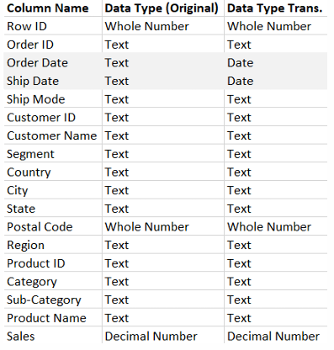
Dataset Info...
Dataset content:
9801 row, 18 columns
Data Type:
Date not fully cleaned:
We have missing values in postal code column we will replace it with the postal code of the city.

Slide 6
Analysis Recommendations...
Current Data Analysis:
◦ Sales Trend Over Time.
◦ Top-Performing Segments & Regions.
◦ Best & Worst Products.
◦ Customer Insights.
◦ Opportunities.
◦ Shipping Efficiency.

Slide 7
Where should the superstore invest next?
◦ Show growth areas (ex: strong sales in Technology).
◦ Show risks (ex: long shipping times in certain regions).
◦ Suggest opportunities (ex: invest in faster logistics, push profitable
categories, nurture repeat customers).

Slide 8
OUR AWESOME PROJECTS

Slide 9
Subjects:
  Questions Creation
  KPI Recommendation
  Columns Creation
  DAX Formula Creation
  Visualization

Slide 10
Adding Columns:
AVG. Shipping
  Duration
  Ship Duration
  Shipping Status
  Customer Status
  Sales Category

Slide 11
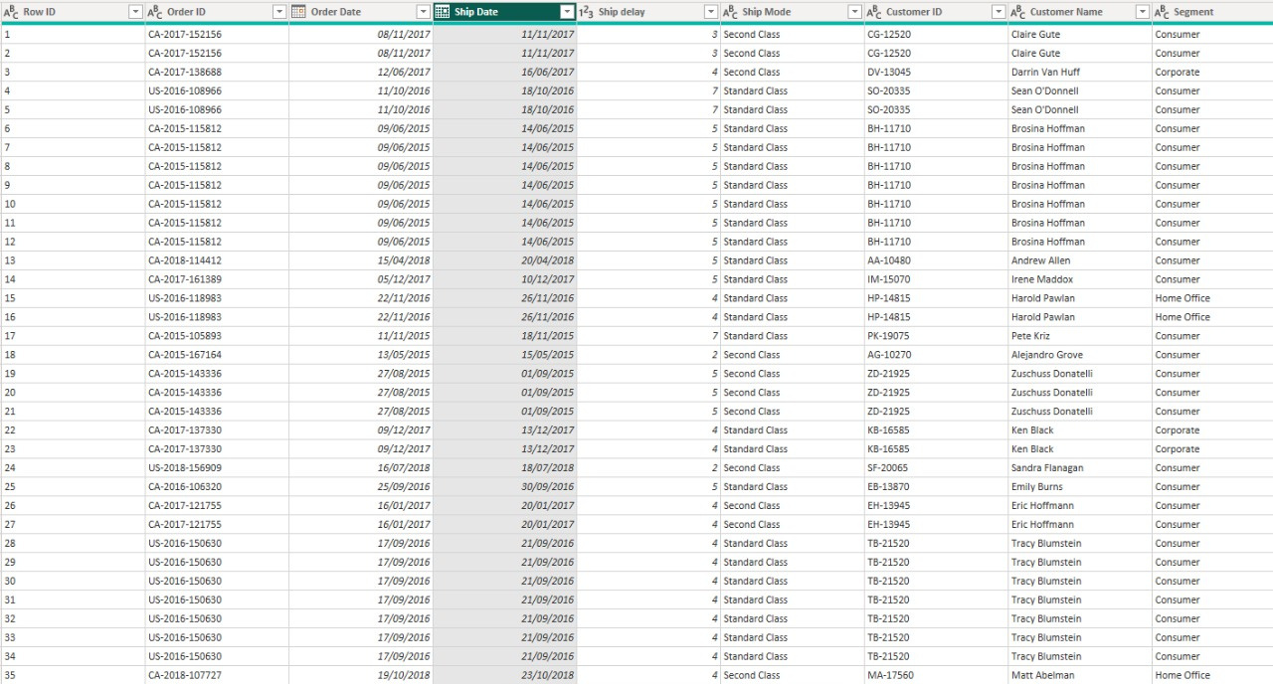
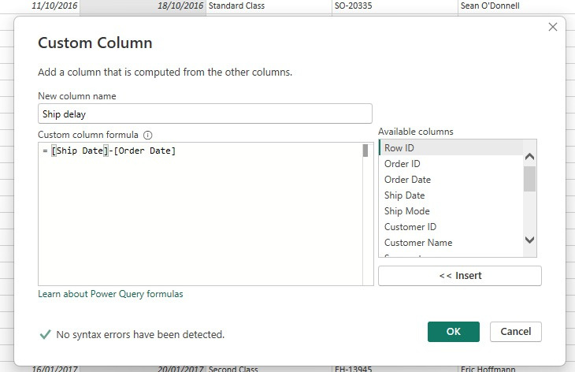
Ship Duration
Creating ship Duration column

Slide 12
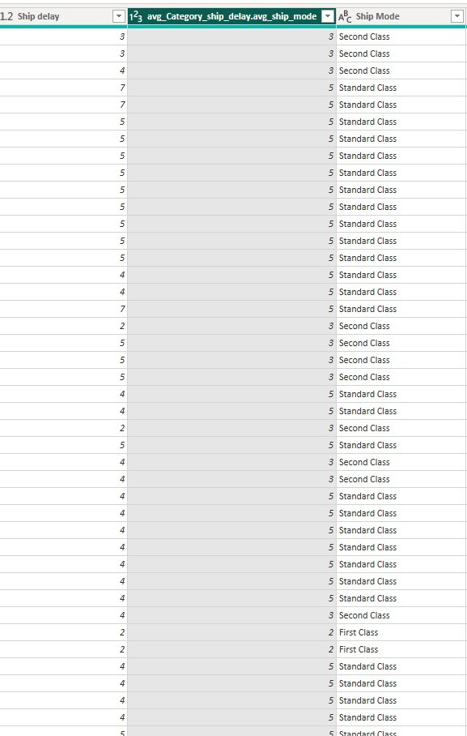
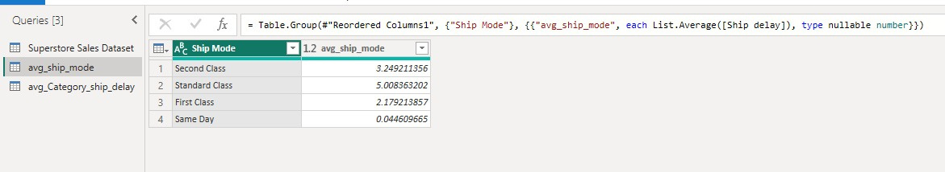
Avg Shipping Duration
Average category ship Duration

Slide 13
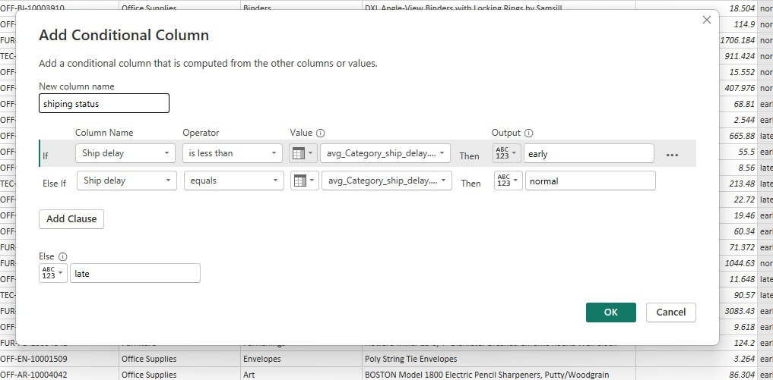
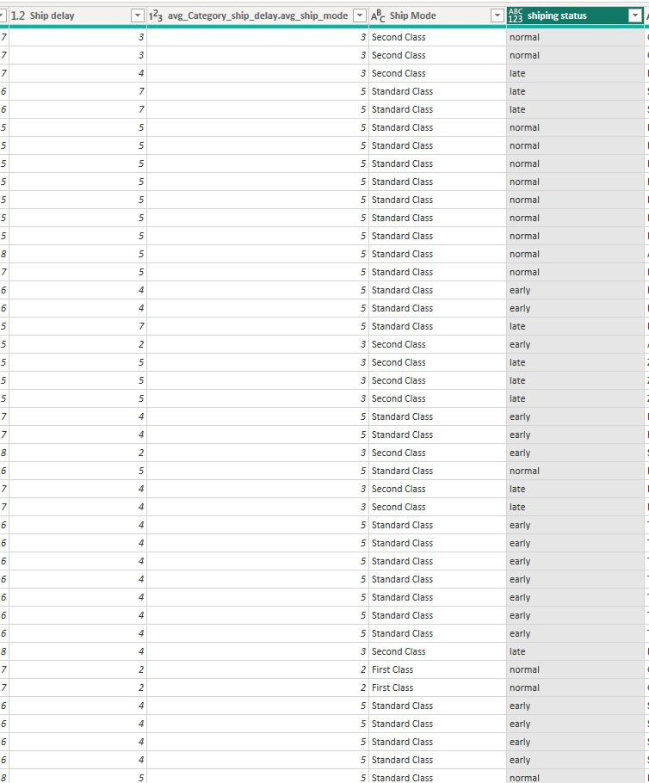
Shipping Status

Slide 14
Remaining for next time
Customer Status
Sales Category

Slide 15
THANK YOU

